Slide 1
Did “industrialization and agricultural collectivization” normalize the skewed sex ratio in China?
Sixue Liu
Computational Social Science
Notes:
A lot of people believe that one child policy is the driver of skewed sex ratio in China. And China’s government now are paying attention to alleviating this problem by loosing the restriction of one child policy. So understanding the skewed sex ratio problem is very important.

Slide 2
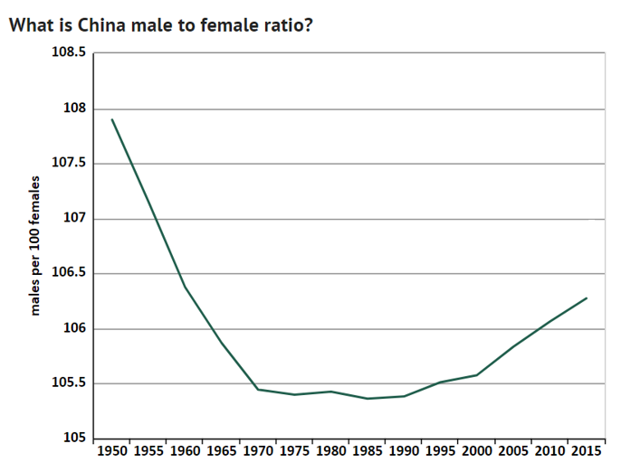
1. Research Background
Source: World Population Prospects: The 2017 Revision
Notes:
The normal range of male to female ratio in the world is below the 105.

Slide 3
2. Research Question
Did “industrialization and agricultural collectivization” normalize the skewed sex ratio in China?
Skewed sex ratio is a serious problem in China, the government is seeking ways to alleviate it.
Understanding the real driver of skewed sex ratio in China.
Analyzing the relationship between one-child policy and sex ratio in China.

Slide 4
3. Literature Review
Most studies of gender imbalances focus on the implementation of the one-child policy.
1) One-child policy (1980)
“Gender discrimination policy” (Loh and Remick 2015)
Whether allowing birth of the second child can improve the gender imbalance problem (Zeng Yi 1993)
2) The Household Responsibility System (1978)
The increase in household’s income
Stronger labor productivity (Almond, Li and Zhang 2013)
3) Technical improvement
B-ultrasound selection reduces gender selection costs (Chen et al 2013)

Slide 5
3. Literature Review
Most studies of gender imbalances focus on the implementation of the one-child policy.
1) One-child policy (1980)
“Gender discrimination policy” (Loh and Remick 2015)
Whether allowing birth of the second child can improve the gender imbalance problem (Zeng Yi 1993)
2) The Household Responsibility System (1978)
The increase in household’s income
Stronger labor productivity (Almond, Li and Zhang 2013)
3) Technical improvement
B-ultrasound selection reduces gender selection costs (Chen et al 2013)

Slide 6
4. Exploring the reasons for raising child
1) Investment/ Production Good (Loh and Remick 2015)
Labor-related incentives
Ritual-related incentives (less important)
Inheritance and property ownership
old-age security-related incentives (most important)
2) Consumer Durables (Beker, 1960)
Consumer preference for children
Notes:
The satisfaction or costs associated with children are morally the same as those associated with other durables.
As consumer durables, children are assumed to provide "utility." The utility from children is compared with that from other goods via a utility function or a set of indifference curves.

Slide 7
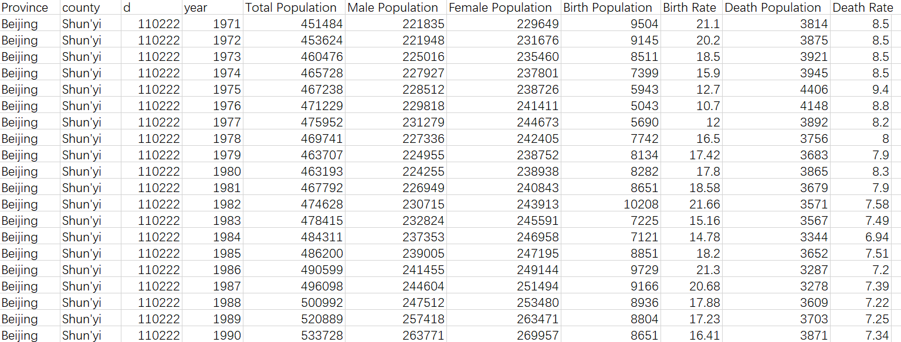
5. Data
Gazetteer Data from county books

Slide 8
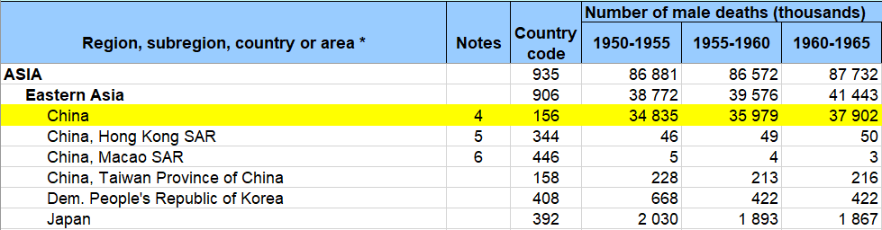
5. Data
2) United Nation Data
Notes:
The good thing is we have county-level data and the bad thing is there are actually some missing data and it is hard to check the accuracy of our data.

Slide 9
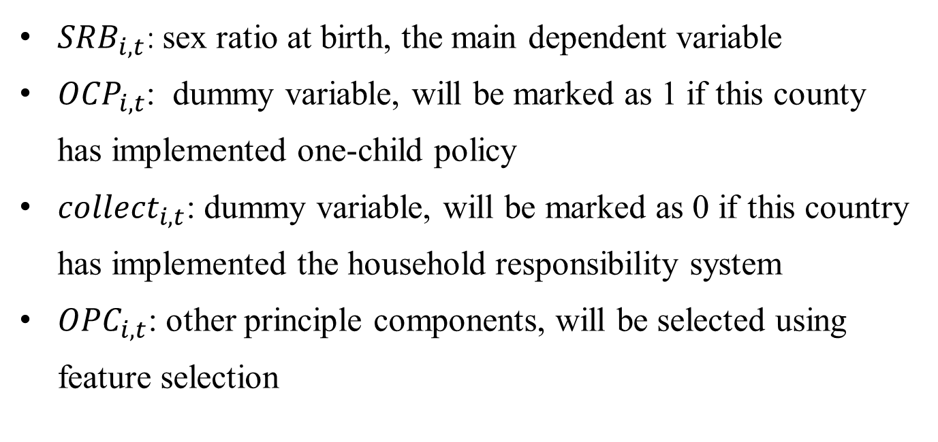
6. Framework Model
$${SRB}_{i,t}=β_{0}+β_{1}∙{OCP}_{i, t}+β_{2}∙{collect}_{i,t}+β_{3}∙{OPC}_{i,t}+u$$
${SRB}_{i,t}$: sex ratio at birth, the main dependent variable
${OCP}_{i, t}$: dummy variable, will be marked as 1 if this county has implemented one-child policy
${collect}_{i,t}$: dummy variable, will be marked as 0 if this country has implemented the household responsibility system
${OPC}_{i,t}$: other principle components, will be selected using feature selection

Slide 10
6. Framework Model
$${SRB}_{i,t}=β_{0}+β_{1}∙{OCP}_{i, t}+β_{2}∙{collect}_{i,t}+β_{3}∙{OPC}_{i,t}+u$$
${SRB}_{i,t}$: sex ratio at birth, the main dependent variable
${OCP}_{i, t}$: dummy variable, will be marked as 1 if this county has implemented one-child policy
${collect}_{i,t}$: dummy variable, will be marked as 0 if this country has implemented the household responsibility system
${OPC}_{i,t}$: other principle components, will be selected using feature selection

